Slide 1

Building Tesla’s Battery Range Calculator with Vue

Slide 2
Agenda workshop

Slide 3


Component based
Focused on the view layer (all browsers)
Integration with Angular or React
Small and compact (21 Kb)

Slide 4
Virtual DOM
Notes:
less expensive:
The changes are not made to the DOM, instead a replica of the DOM is created which is present in the form of JavaScript data structures. Whenever any changes are to be made, they are made to the JavaScript data structures and the latter is compared with the original data structure. The final changes are then updated to the real DOM.

Slide 5
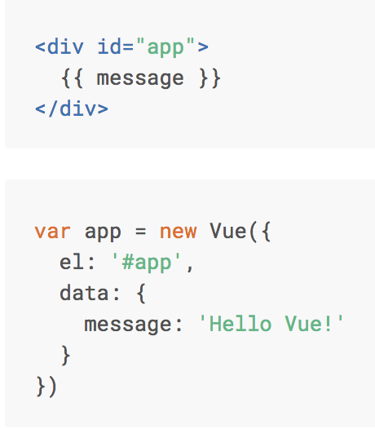

Basics Vue.js

Slide 6
Interpolation
<span> Message: {{ message }} </span>

Slide 7
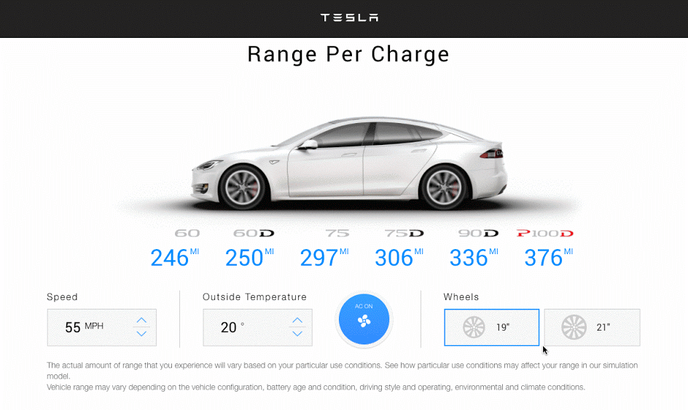

Slide 8
Live version
http://react-tesla-charge-calculator.surge.sh/

Slide 9
Component based

Slide 10
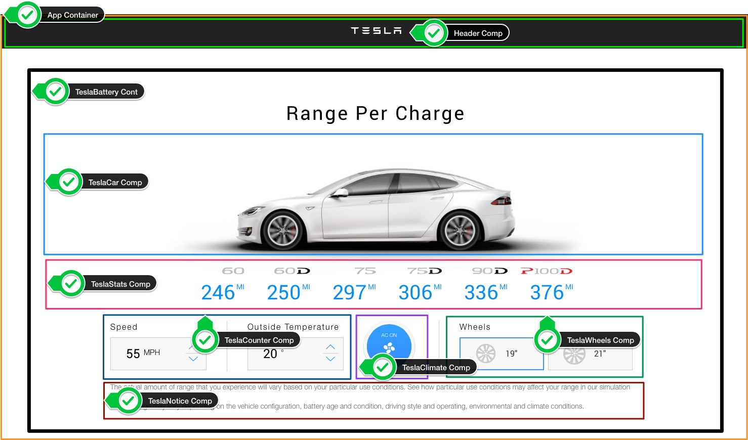

Slide 11
The UI is represented by a component tree
<App> -- Application entry point <TeslaHeader></TeslaHeader> <TeslaBattery> -- Container Component <TeslaCar /> -- Presentational Component <TeslaStats /> -- Presentational Component <TeslaCounter /> -- Presentational Component <TeslaClimate /> -- Presentational Component <TeslaWheels /> -- Presentational Component <TeslaNotice /> -- Presentational Component </TeslaBattery> </App>

Slide 12
Components tree
Main.js
App.vue
TeslaBattery
→ Container Component
props
props
props
props
props
TeslaCar
TeslaStats
TeslaCounter
TeslaClimate
TeslaWheels
Presentational Components

Slide 13
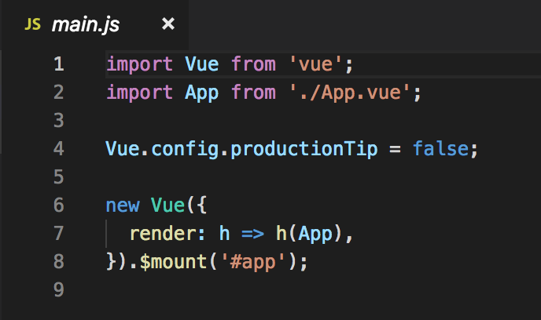
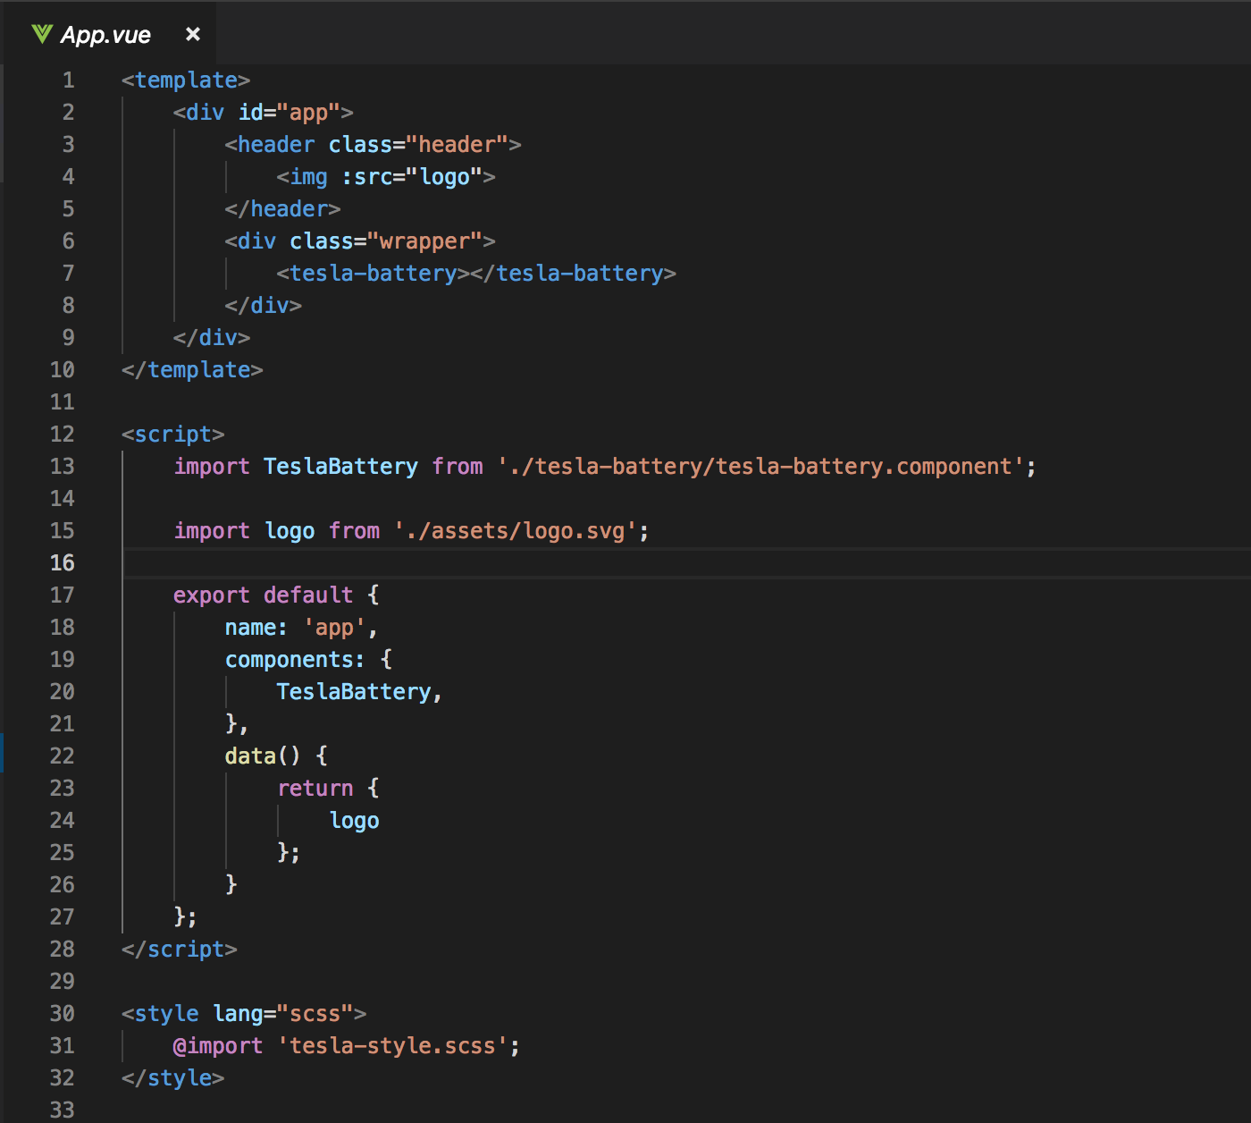
Entry Point
main.js
App.vue

Slide 14
Components tree
Main.js
App.vue
TeslaBattery
props
props
props
props
props
TeslaCar
TeslaStats
TeslaCounter
TeslaClimate
TeslaWheels

Slide 15
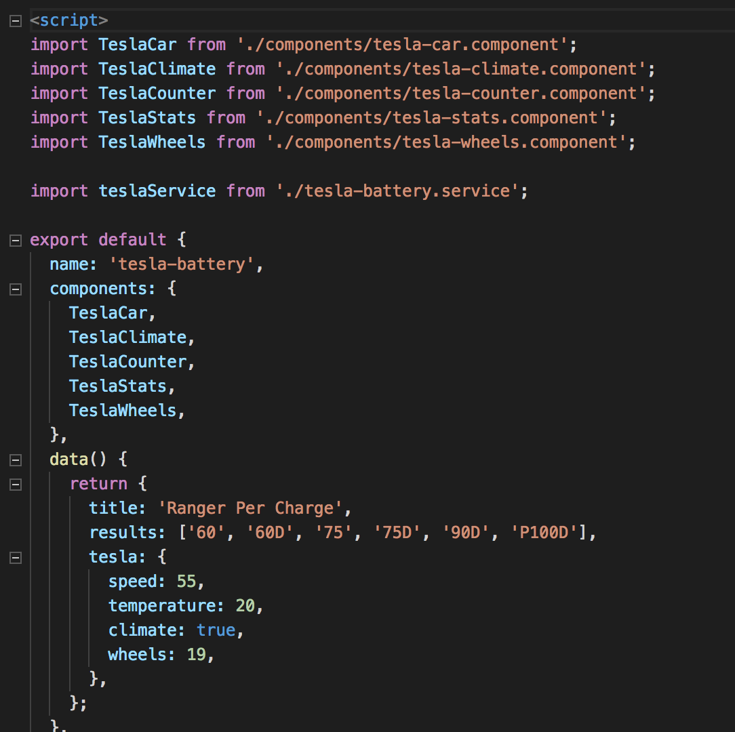
Tesla Battery Component (Container component)

Slide 16
Container Component (stateful component)
Are concerned with how things work.
Provide data and actions to presentational or other container components.
Are often stateful, as they tend to serve as data sources.

Slide 17
Presentational Component (stateless component)
Are concerned with how things look.
Usually have some DOM markup and styles of their own.
Receive data and callbacks exclusively via props.
Rarely have their own state (when they do, it’s UI state rather than data).

Slide 18
What are the benefits of using these patterns?
Better separation of concerns
Better reusability
Extract layout components to prevent duplication

Slide 19
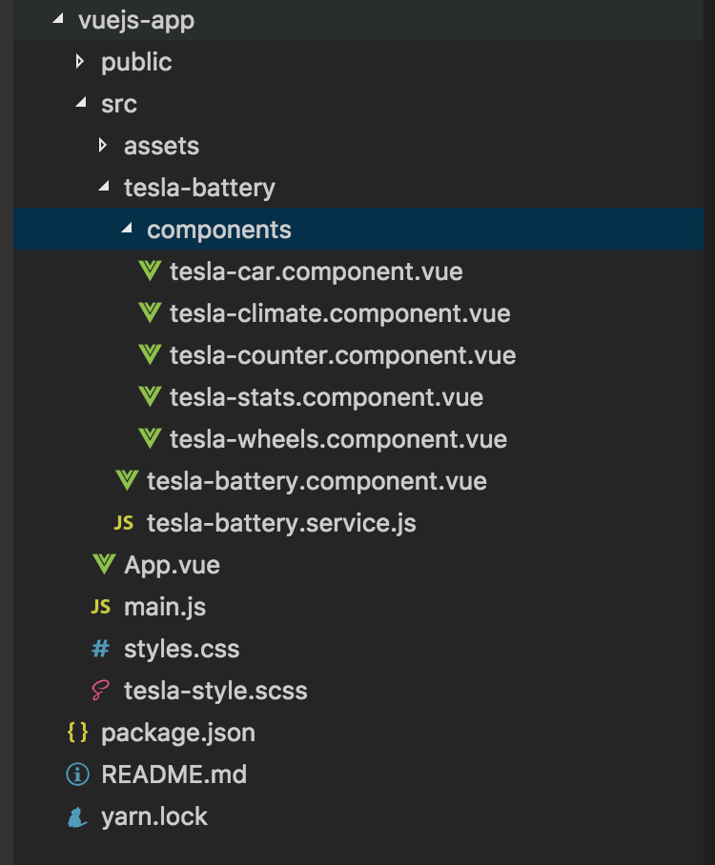

Slide 20
How to create a tesla.header.component?
App.vue
props: “greeting”
TeslaHeader
TeslaBattery
props
props
props
props
props
TeslaCar
TeslaStats
TeslaCounter
TeslaClimate
TeslaWheels

Slide 21
tesla-header.component
Step1 Create a tesla-header.component.vue file
Step 2 Import tesla-header.component in App.vue

Slide 22
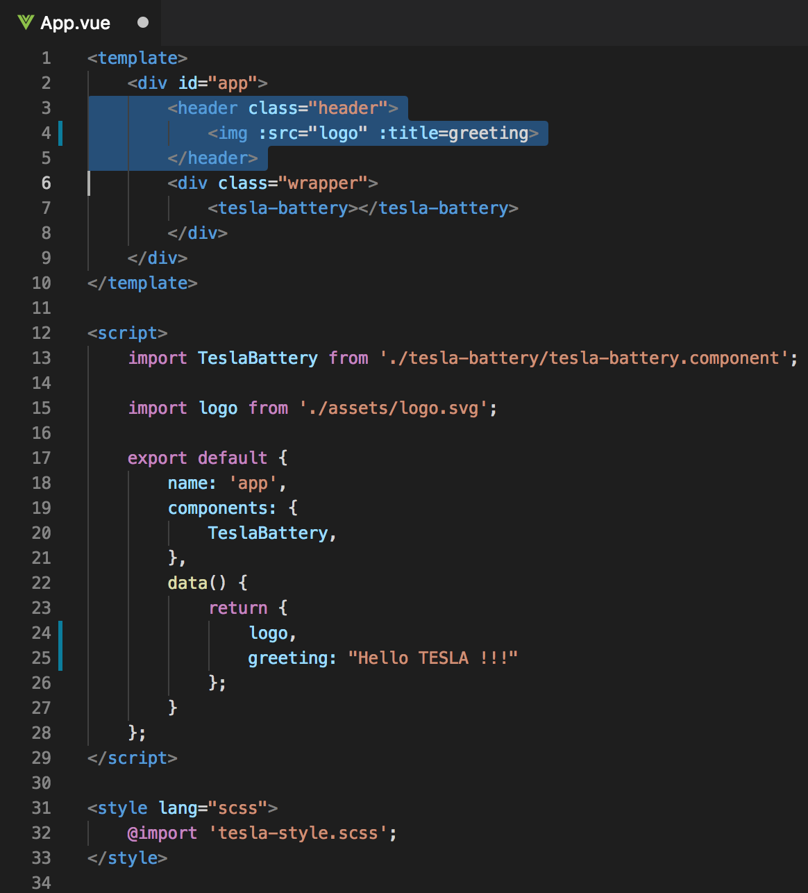
Current App.vue

Slide 23
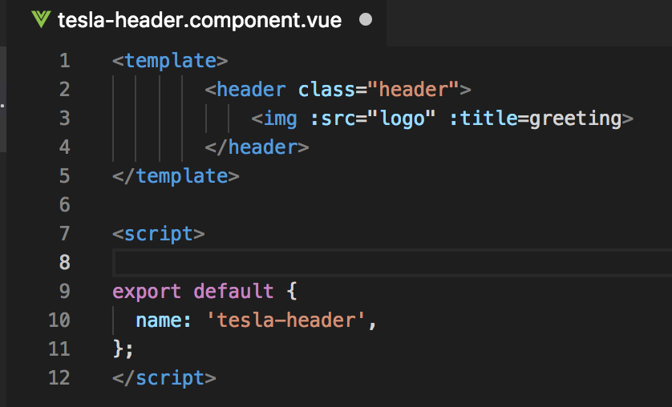
Step1 tesla-header.component.vue

Slide 24
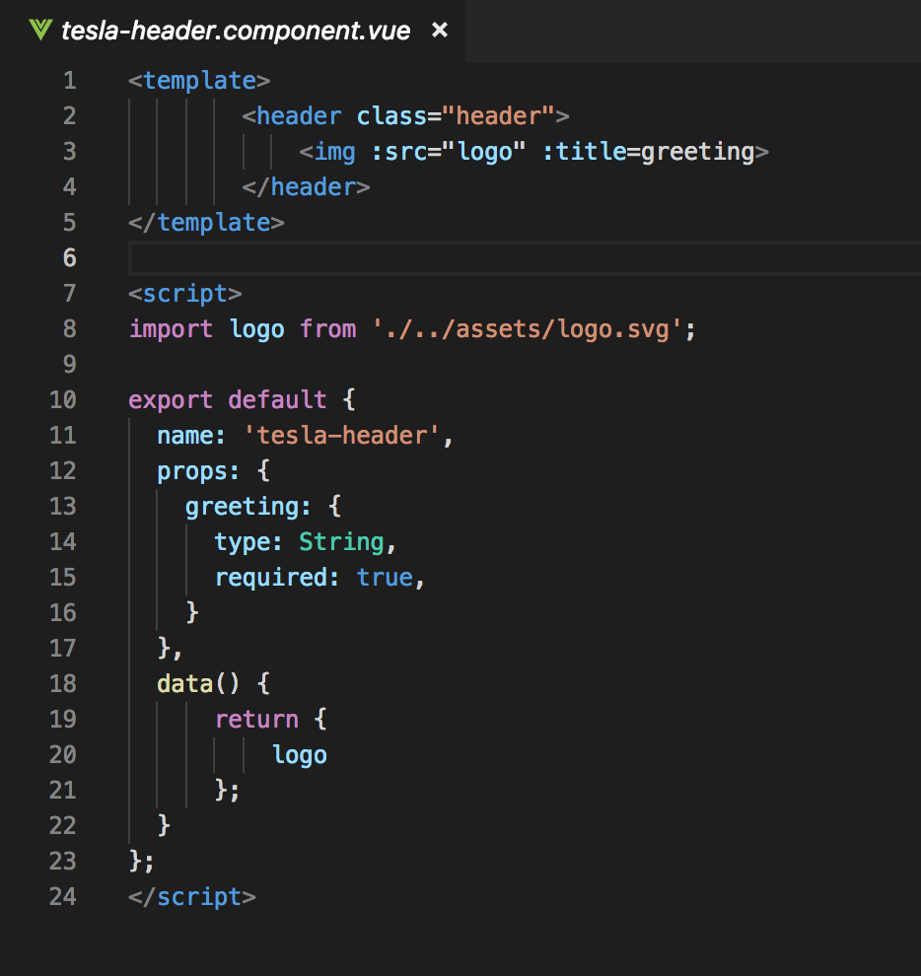
Step1 tesla-header.component.vue
Notes:
Name
Props → logo

Slide 25
Components tree
App.vue
props: “greeting”
TeslaHeader
TeslaBattery
props
props
props
props
props
TeslaCar
TeslaStats
TeslaCounter
TeslaClimate
TeslaWheels

Slide 26
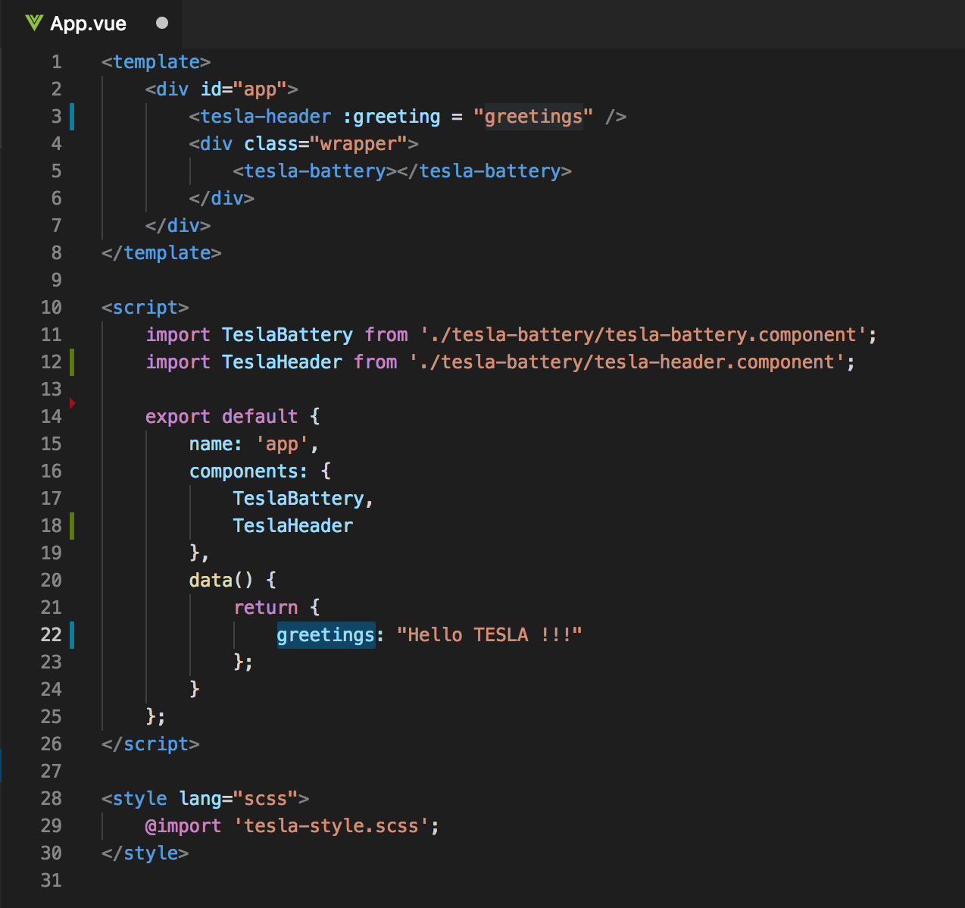
Step 2 Import tesla-header.component in App.vue
Old
New

Slide 27
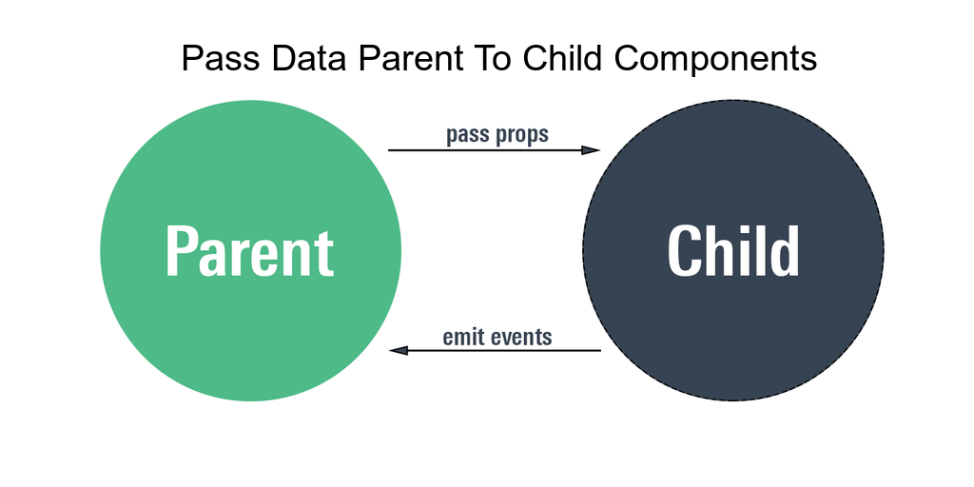

Slide 28
Components tree
App.vue
props: “greeting”
TeslaHeader
TeslaBattery
props
props
props
props
props
TeslaCar
TeslaStats
TeslaCounter
TeslaClimate
TeslaWheels

Slide 29
Pass Props
<tesla-header :greeting= “greetings” />

Slide 30
Emit events
App.vue
props: “greeting”
TeslaHeader
TeslaBattery
emit
props
props
props
props
props
TeslaCar
TeslaStats
TeslaCounter
TeslaClimate
TeslaWheels

Slide 31
Emit events

Slide 32
Tesla Battery Component (Container component)

Slide 33
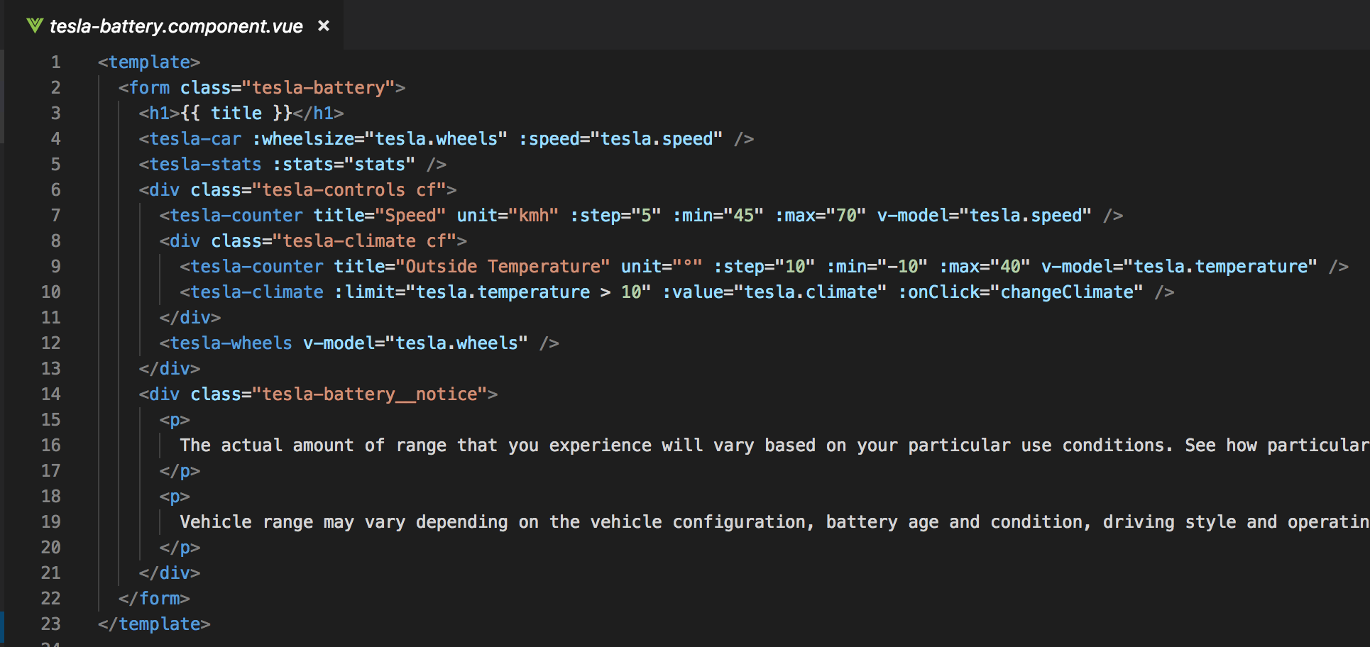
Tesla Battery Component (template)

Slide 34
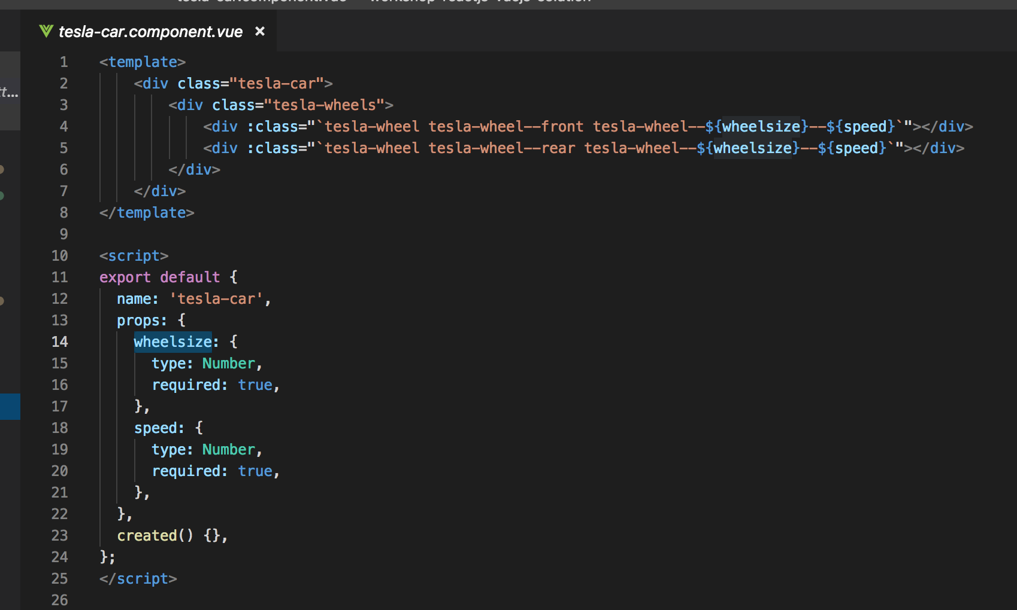
TeslaCar

Slide 35
Data service => TeslaBattery.service
Structure data:
Models –> wheels – climate – speed - temparature
Models = '60', '60D', '75', '75D', '90D', 'P100D'

Slide 36
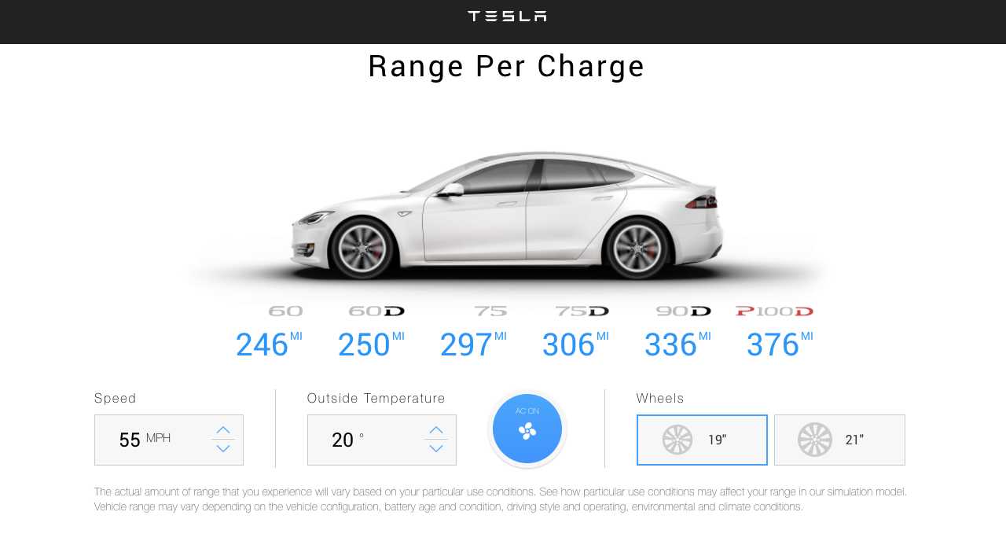
Exercise: check TeslaBattery.service model

Slide 37
Weetjes:
tesla-battery.component → stats()-method (voor het calculceren van de maximale battery range) is called als er een parm veranderd (wheels – climate – speed - temparature)
tesla-battery.component → change parms (wheels – climate – speed - temparature) wordt middle 2-way databinding doorgegeven →zie tesla-battery.component v-model en $emit → value

Slide 38
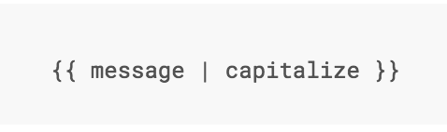
Filter
Notes:
Vue.js allows you to define filters that can be used to apply common text formatting.

Slide 39
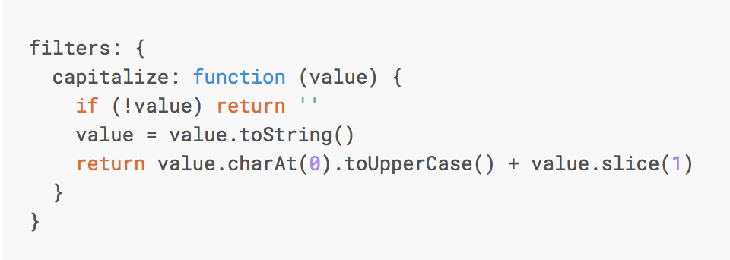
Custom Filter
Notes:
You can define local filters in a component’s options:

Slide 40
TODO
Uitleg component
Uitleg data binding + 2 way databinding
@onBlur @onclick @onfocus. OF :onClick
Name, Props, data(), Methods, Computed() in Child components
Start app with root Vue: new Vue()
Computed properties en watchers

Slide 41
DIRECTIVES
Notes:
Directives are special attributes with the v- prefix. Directive attribute values are expected to be a single JavaScript expression (with the exception of v-for, which will be discussed later). A directive’s job is to reactively apply side effects to the DOM when the value of its expression changes.

Slide 42
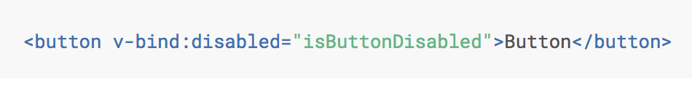
v-bind
Notes:
If isButtonDisabled has the value of null, undefined, or false, the disabled attribute will not even be included in the rendered <button> element.

Slide 43
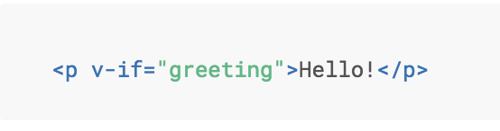
Directive v-if
Notes:
Here, the v-if directive would remove/insert the <p> element based on the truthiness of the value of the expression greeting.

Slide 44
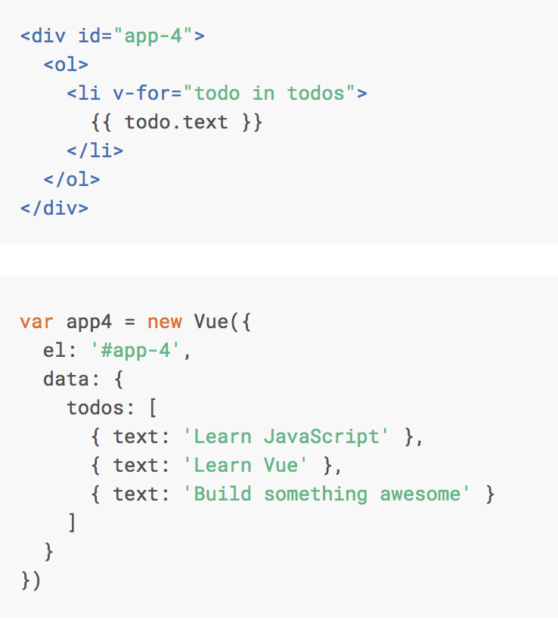

Directive v-for

Slide 45
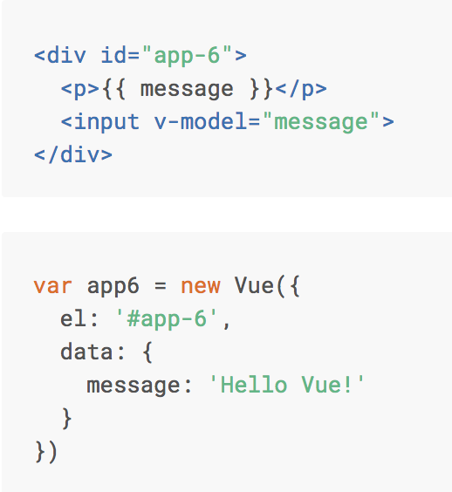
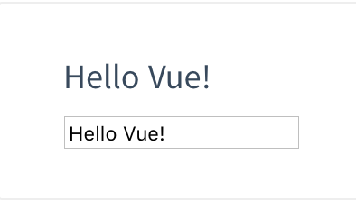
Directive v-model

Slide 46
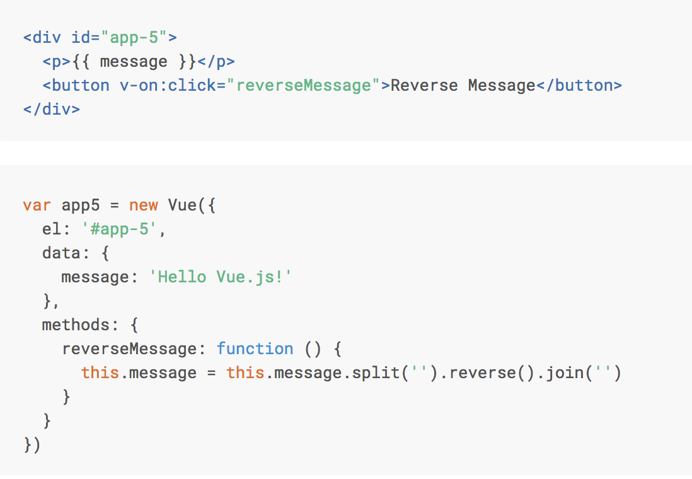
Directive v-on:click

Slide 47
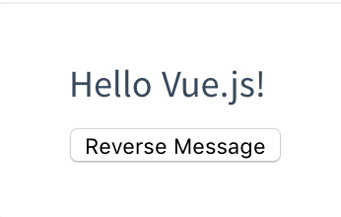
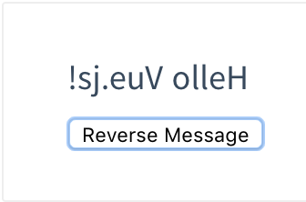
Directive v-on:click

Slide 48
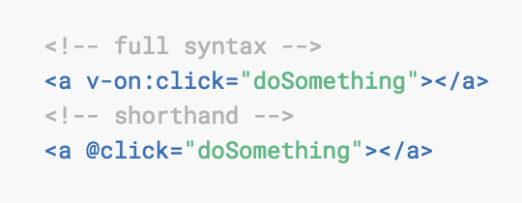
v-on:click Shorthand

Slide 49
@blur.stop.prevent

